Slide 1



FitPulse Analytics
Enterprise Health Data Intelligence Platform
Technical Product Documentation
By Abhishek Shah

Slide 2









Strategic Value Proposition
Data Quality
Scalability
Insight Velocity
Automated five-layer null remediation eliminates manual data-cleaning effort, reducing pre-analysis preparation time by an estimated 70–85%.
Handles datasets from hundreds to tens of thousands of rows with consistent performance, leveraging Pandas vectorised operations.
Full Exploratory Data Analysis (EDA)—including descriptive stats, correlations, and distributions—delivered in a single button click.

Slide 3

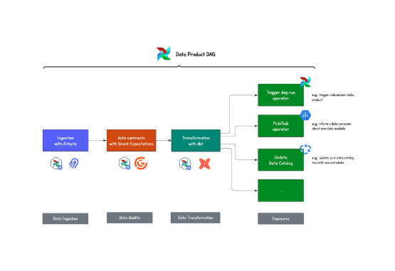
The Data Quality Challenge
Addressing Raw Dataset Deficiencies
Raw fitness and health datasets—sourced from wearable devices, HR management systems, wellness applications, and manual entry—invariably arrive with significant data quality deficiencies.
•
Pervasive Null Values: Gaps in tracking creating analytical blind spots.
•
Inconsistent Formats: Date parsing errors and unmapped categorical entries.
•
Structural Irregularities: Primary barriers to meaningful pattern analysis.
FitPulse Analytics dissolves these barriers through intelligent, fully automated data remediation, enabling analysts to proceed directly to insight generation.

Slide 4
Target Audience & Primary Use Cases
User Segment | Primary Use Case | Key Platform Benefit
Corporate HR & Wellness | Employee fitness programme monitoring and reporting. | No-code EDA with export-ready visualisations.
Data Analysts & Scientists | Rapid dataset profiling and null-value auditing. | Automated preprocessing reduces setup time significantly.
Healthcare Admins | Patient fitness metric trend analysis. | Time-series and outlier detection built-in.
Product Managers | Fitness platform data quality reviews. | Pipeline audit log provides full operational transparency.
Business Intelligence | KPI dashboards fed from cleaned datasets. | Clean, structured data ready for downstream BI tools.

Slide 5




Five-Stage Pipeline Architecture
2. Null Inspection
4. EDA Generation
Column-level null counts, heatmaps, and KPI audits to isolate missing fitness metrics.
8 interactive charts including distributions, correlations, and time series generated instantly.
1. CSV Ingestion
3. Preprocessing
Raw .csv file to In-memory DataFrame via robust encoding detection and file-state guard.
Deterministic 5-layer null remediation guaranteeing complete null elimination.

Slide 6


Stages 1 & 2: Ingestion & Inspection
Stage 1: CSV Upload
Stage 2: Null Value Inspector
Embedded within the sidebar, utilising Streamlit's native file_uploader widget styled with the platform's custom CSS.
Delivers a comprehensive multi-dimensional audit of missing data, architected as a self-contained module.
•
Capacity: Accepts CSV files up to 200 MB via drag-and-drop.
•
KPI Cards: Total Null Cells, Affected Columns, Clean Columns, Null Rate.
•
Architecture: Implements a file-name guard; session state resets exclusively upon detection of a genuinely new file.
•
Visualizations: Horizontal bar chart ranked by null severity (purple → red).
•
Heatmap: 500-row sample null presence heatmap for immediate visual pattern identification.
•
Feedback: Animated loader provides real-time progress while displaying 4 initial KPI cards.

Slide 7
Stage 3: The 5-Layer Preprocessing Engine
Layer A: Datetime Parsing Columns containing date/time keywords are parsed to datetime64[ns], preparing them for accurate time-series analysis and normalizing invalid values.
Layer B: Linear Interpolation Intelligently fills gaps between known numeric values. This is ideal for time-ordered fitness metrics like step counts or heart rate tracking.
Layer C & D: Forward (ffill) & Backward (bfill) Fill Propagates the last known value forward (addressing trailing nulls) and the next known value backward (addressing leading nulls) to ensure continuity.
Layer E: Median, Mode & Safety Net Absolute fallback utilizing column median for isolated numerics, mode for categorical nulls, and a final sweep to guarantee 100% null elimination.

Slide 8



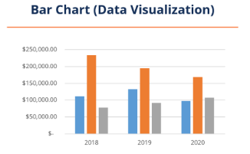
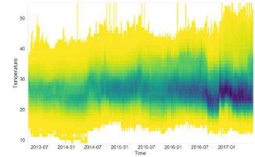
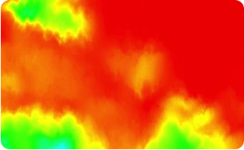
Stage 5: Exploratory Data Analysis (EDA)
Distributions
Time Series Trends
Correlation Matrix
Histograms per numeric column in responsive grids, alongside horizontal bar charts mapping top categorical values.
Weekly-average line charts with area fill and monthly-average bar charts utilizing pandas resampling protocols.
Pearson correlation heatmap for all numeric features, annotated with r-values to map physiological relationships.

Slide 9
Future Development Roadmap
Release | Feature | Business Value
v1.1 | CSV & PDF Report Export | Board-ready reports; enables downstream use in Power BI, Tableau, and ML pipelines.
v1.2 | Multi-file Upload | Upload and merge up to 5 CSV files via configurable join key to consolidate health data.
v1.2 | Statistical Tests | Adds inferential capability (Mann-Whitney U, Kruskal-Wallis) for deep research use.
v1.3 | User Authentication | Streamlit-Authenticator integration enabling multi-user enterprise deployment with access control.
v2.0 | ML Anomaly Detection | Isolation Forest-based anomaly flagging for proactive detection of unusual fitness metric patterns.

Slide 10
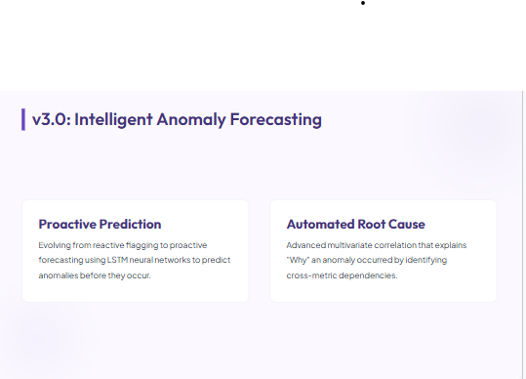

Slide 11
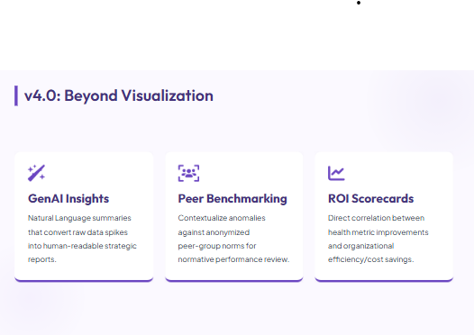

Slide 12
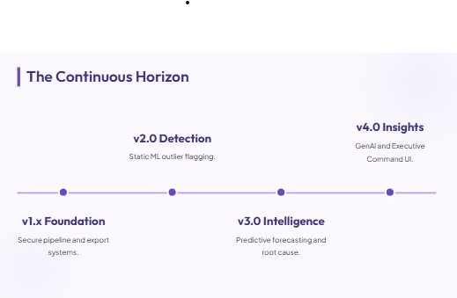

Slide 13
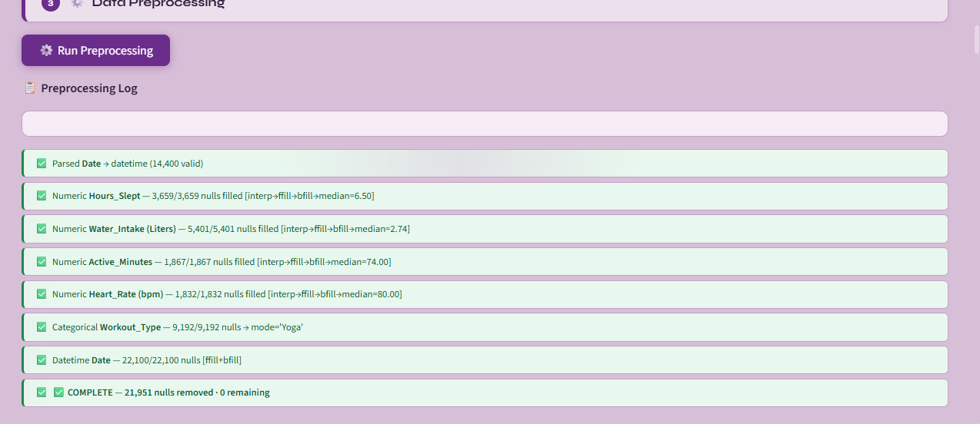
Milestone-1 Preprocessing

Slide 14
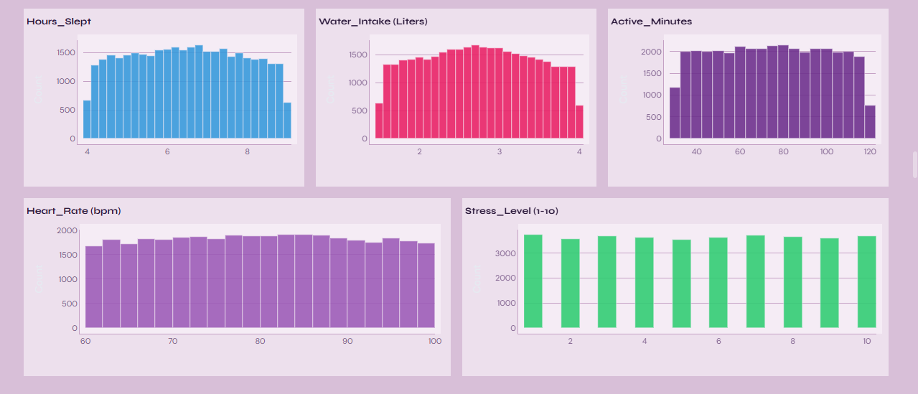

Slide 15
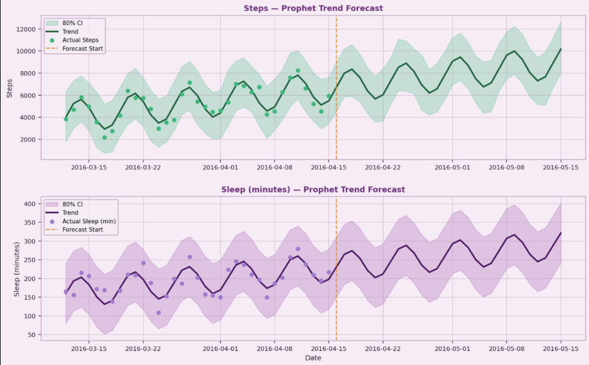
Milestone-2 Pattern extraction

Slide 16
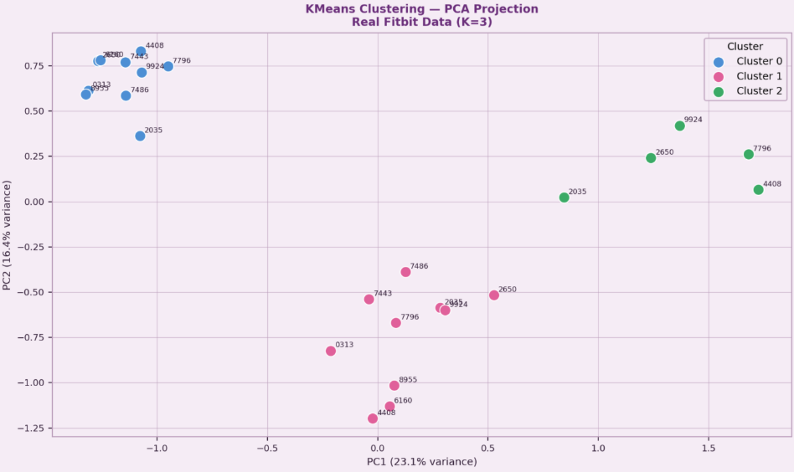

Slide 17
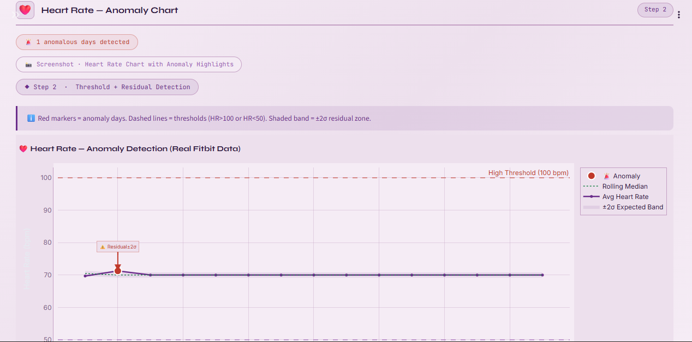
Milestone-3 Anomaly detection

Slide 18
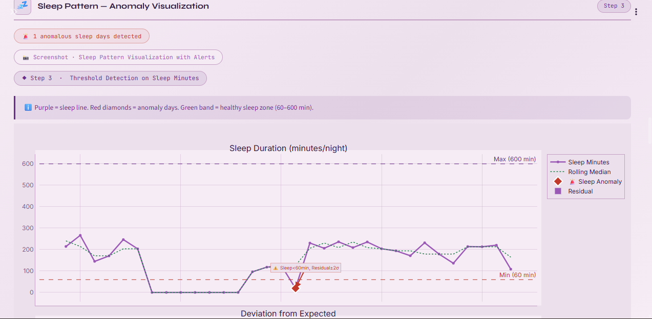

Slide 19
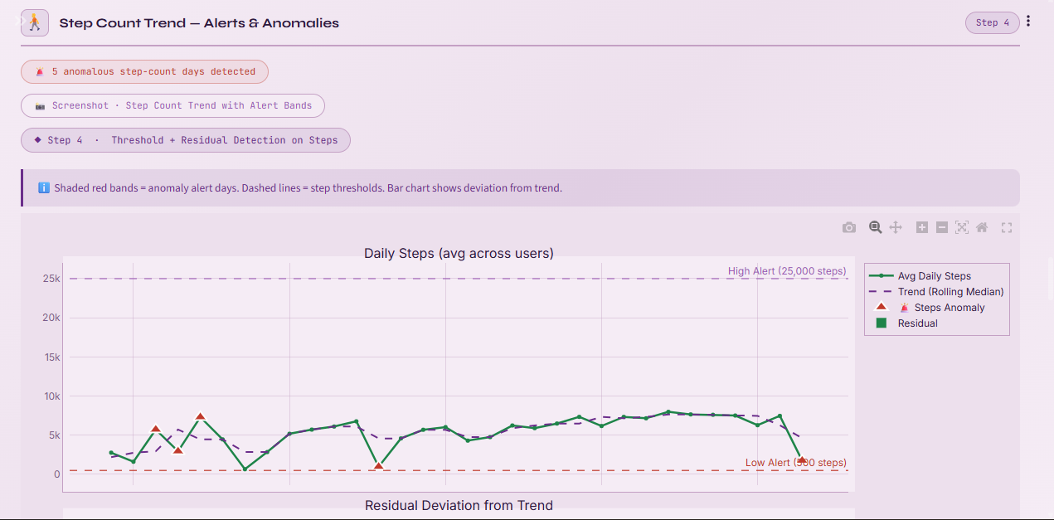

Slide 20
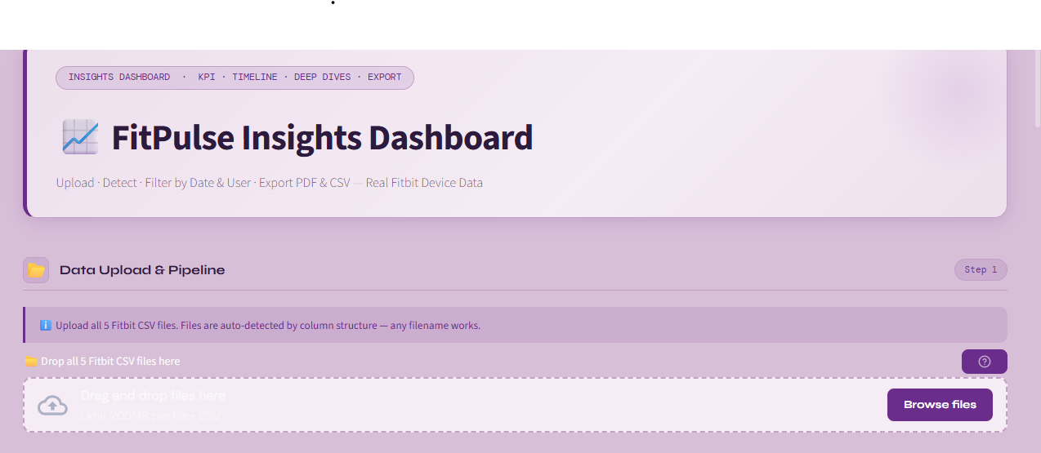
Milestone-4 Dashboard

Slide 21
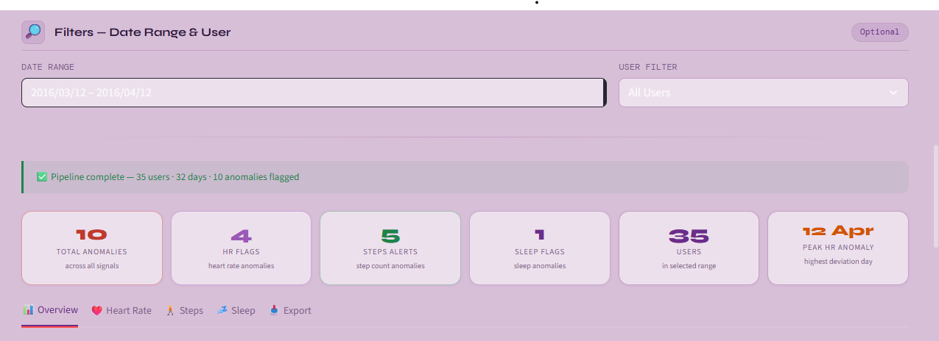

Slide 22
